Slide 1
Wise County Transportation Plan
Trb transportation planning applications conference
Portland, Oregon
June 4, 2019
Planning for a rural county when the regional travel demand model is not the optimal tool

Slide 2
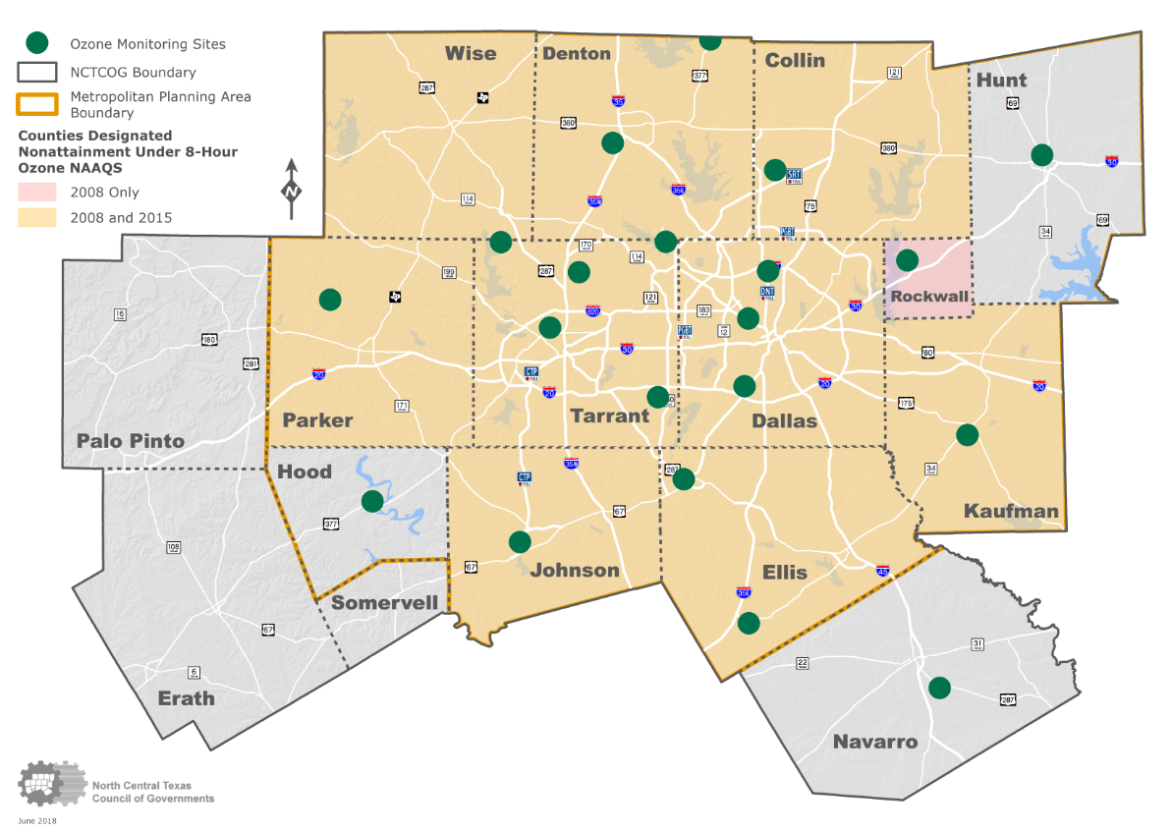
NCTCOG Metropolitan Planning Area With 8-Hour Ozone nonattainment Area
Wise county transportation plan

Slide 3
2045 County Population forecast
Wise county transportation plan
3
County | 2005 | 2018 | 2045
Collin | 647,831 | 969,730 | 1,689,170
Dallas | 2,224,183 | 2,529,150 | 3,445,189
Denton | 541,622 | 844,260 | 1,346,314
Ellis | 128,123 | 183,360 | 300,955
Hood | 45,934 | 65,060 | 85,739
Hunt | 80,978 | 95,960 | 134,291
Johnson | 138,231 | 168,890 | 262,868
Kaufman | 86,119 | 119,670 | 224,205
Parker | 98,950 | 131,210 | 206,811
Rockwall | 59,578 | 97,990 | 181,561
Tarrant | 1,587,173 | 1,989,810 | 3,263,616
Wise | 54,568 | 62,700 | 105,796
Region | 5,695,295 | 7,257,790 | 11,246,516
Data Sources: NCTCOG

Slide 4
Wise county transportation plan
4
Roadway Identification Criteria
Federal Functional Classification System (FFCS)
All roads listed as a major collector or above in the FFCS
Regionally Significant Arterials (RSA)
All roads listed as an RSA in Mobility 2040
Traffic Counts (TxDOT and Wise County Counts)
City and county facilities with relatively high traffic counts
Projected 2040 Volumes
City and county facilities with significant growth between 2017 to 2040
Mobility 2040 Improvements
Roadways with improvements already listed in Mobility 2040
Potential Corridors of Arterial Need (PCAN)
N/S, E/W corridor connector with 5-mile maximum spacing

Slide 5
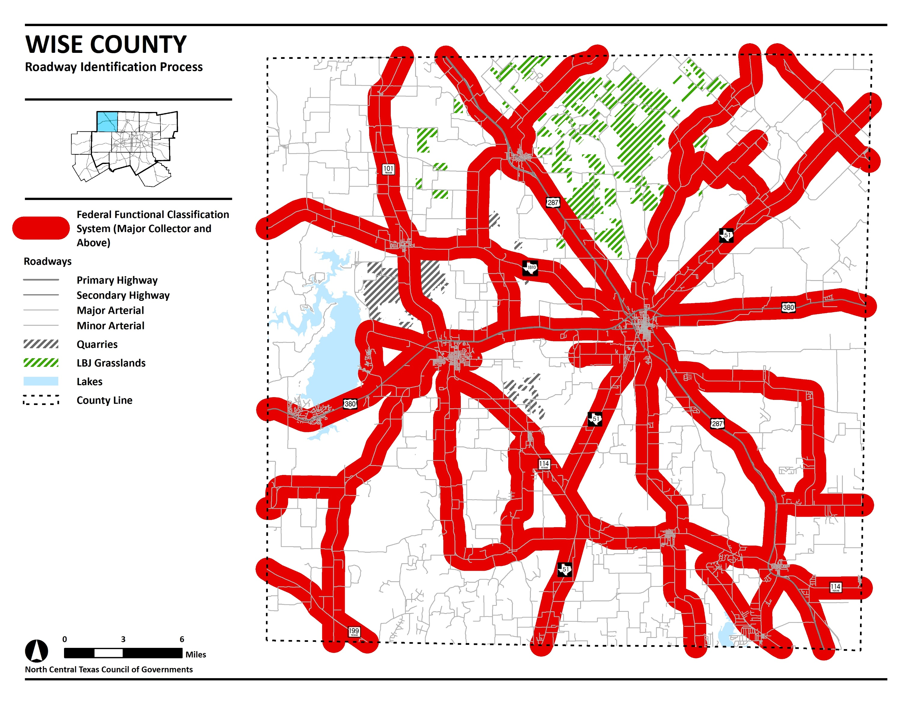
5
DRAFT DOCUMENT

Slide 6
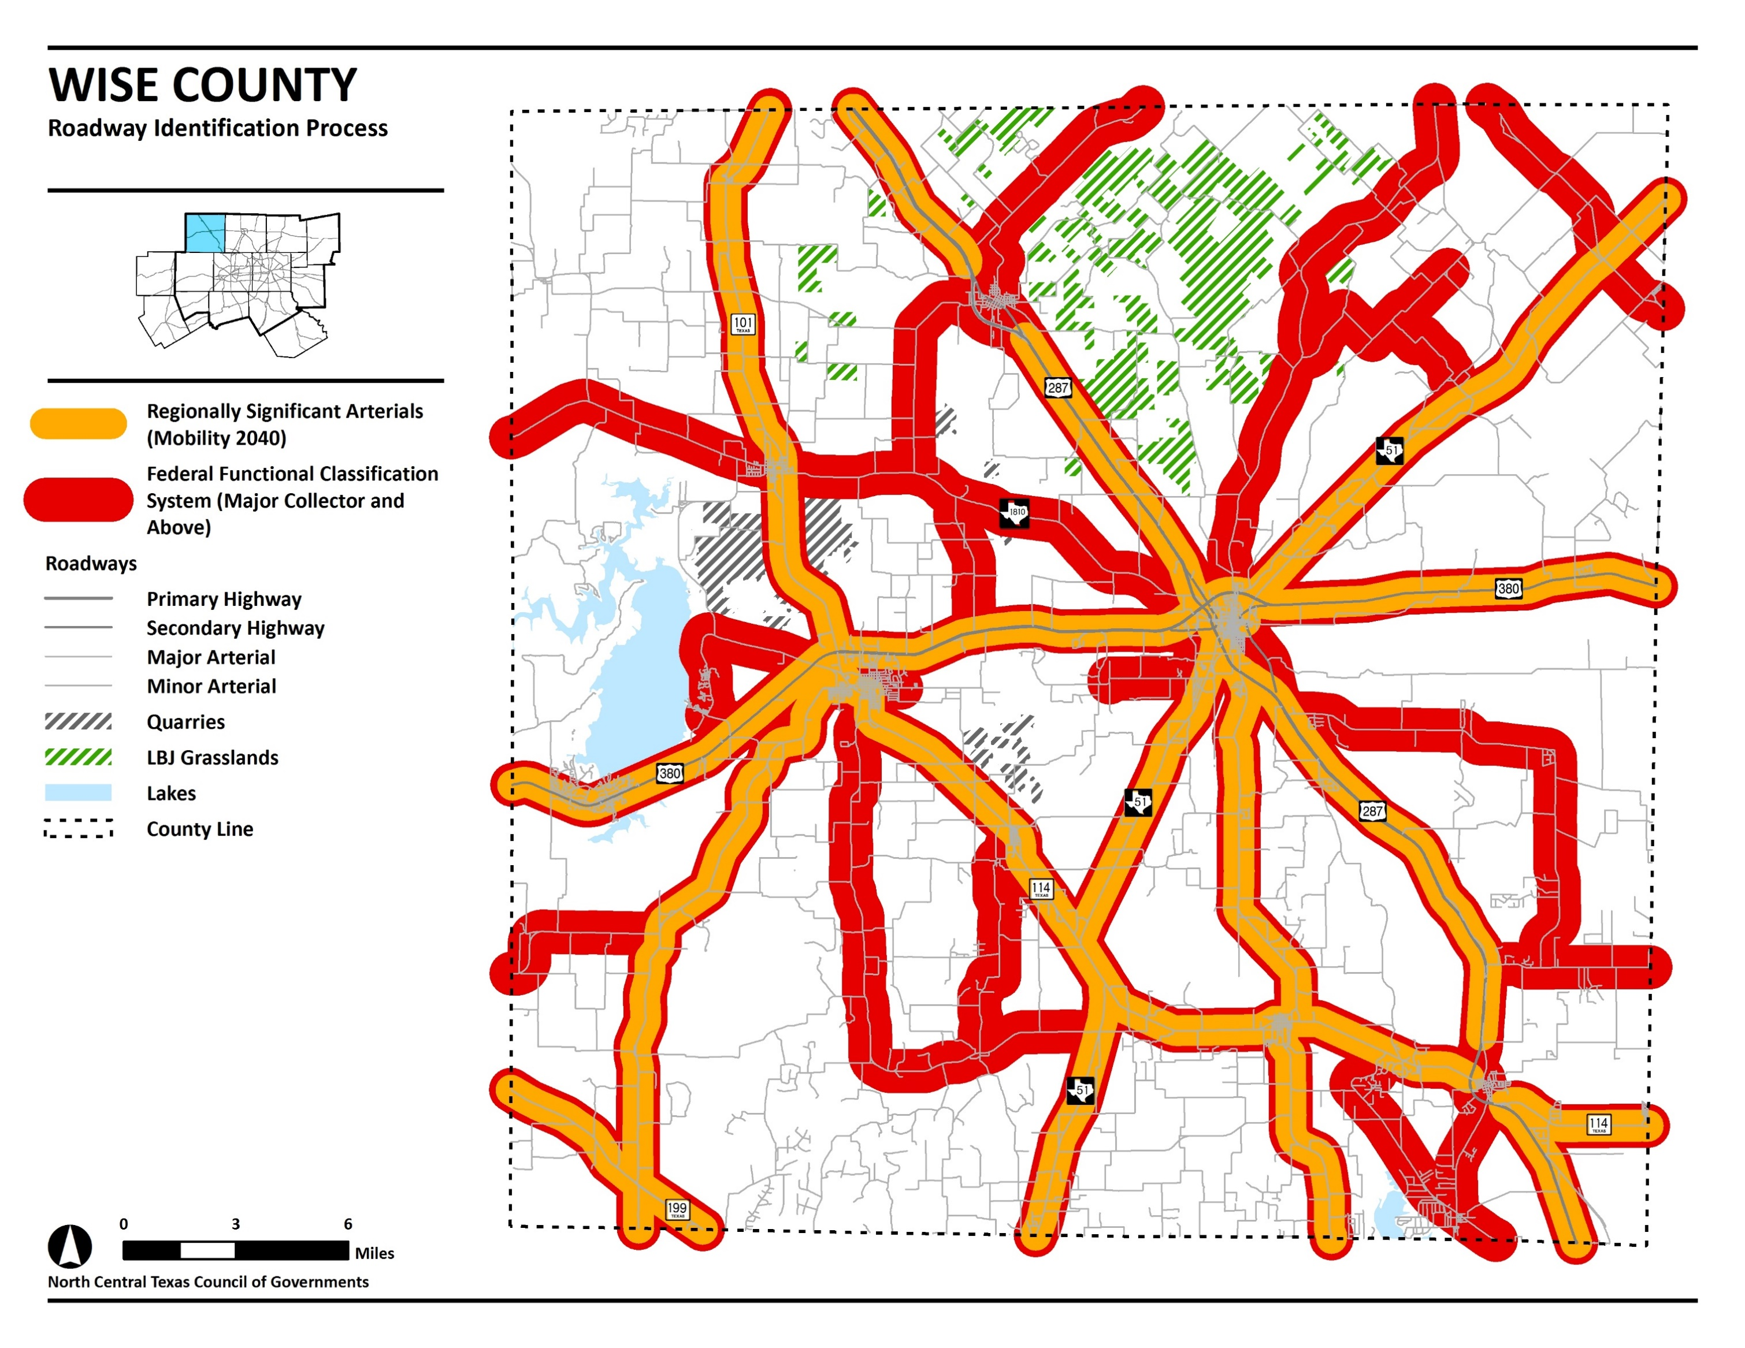
6
DRAFT DOCUMENT

Slide 7
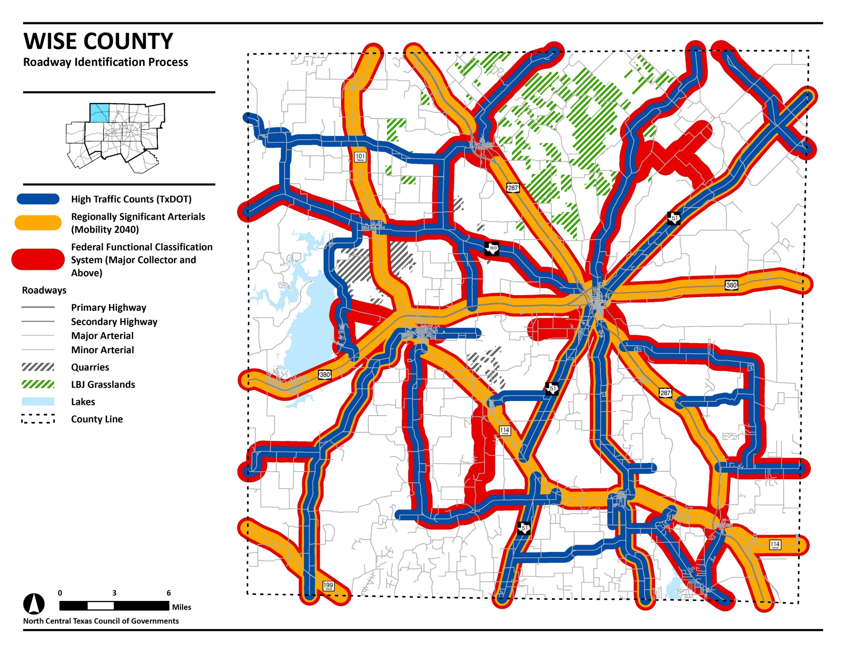
7
DRAFT DOCUMENT

Slide 8
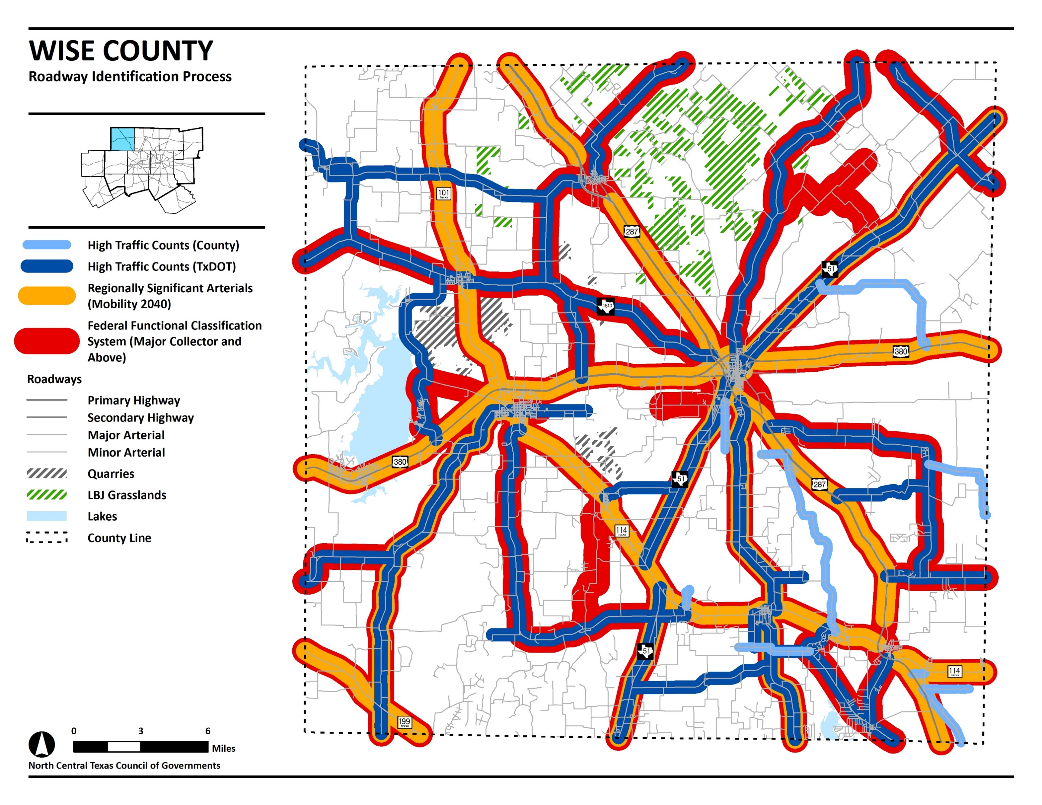
8
DRAFT DOCUMENT

Slide 9
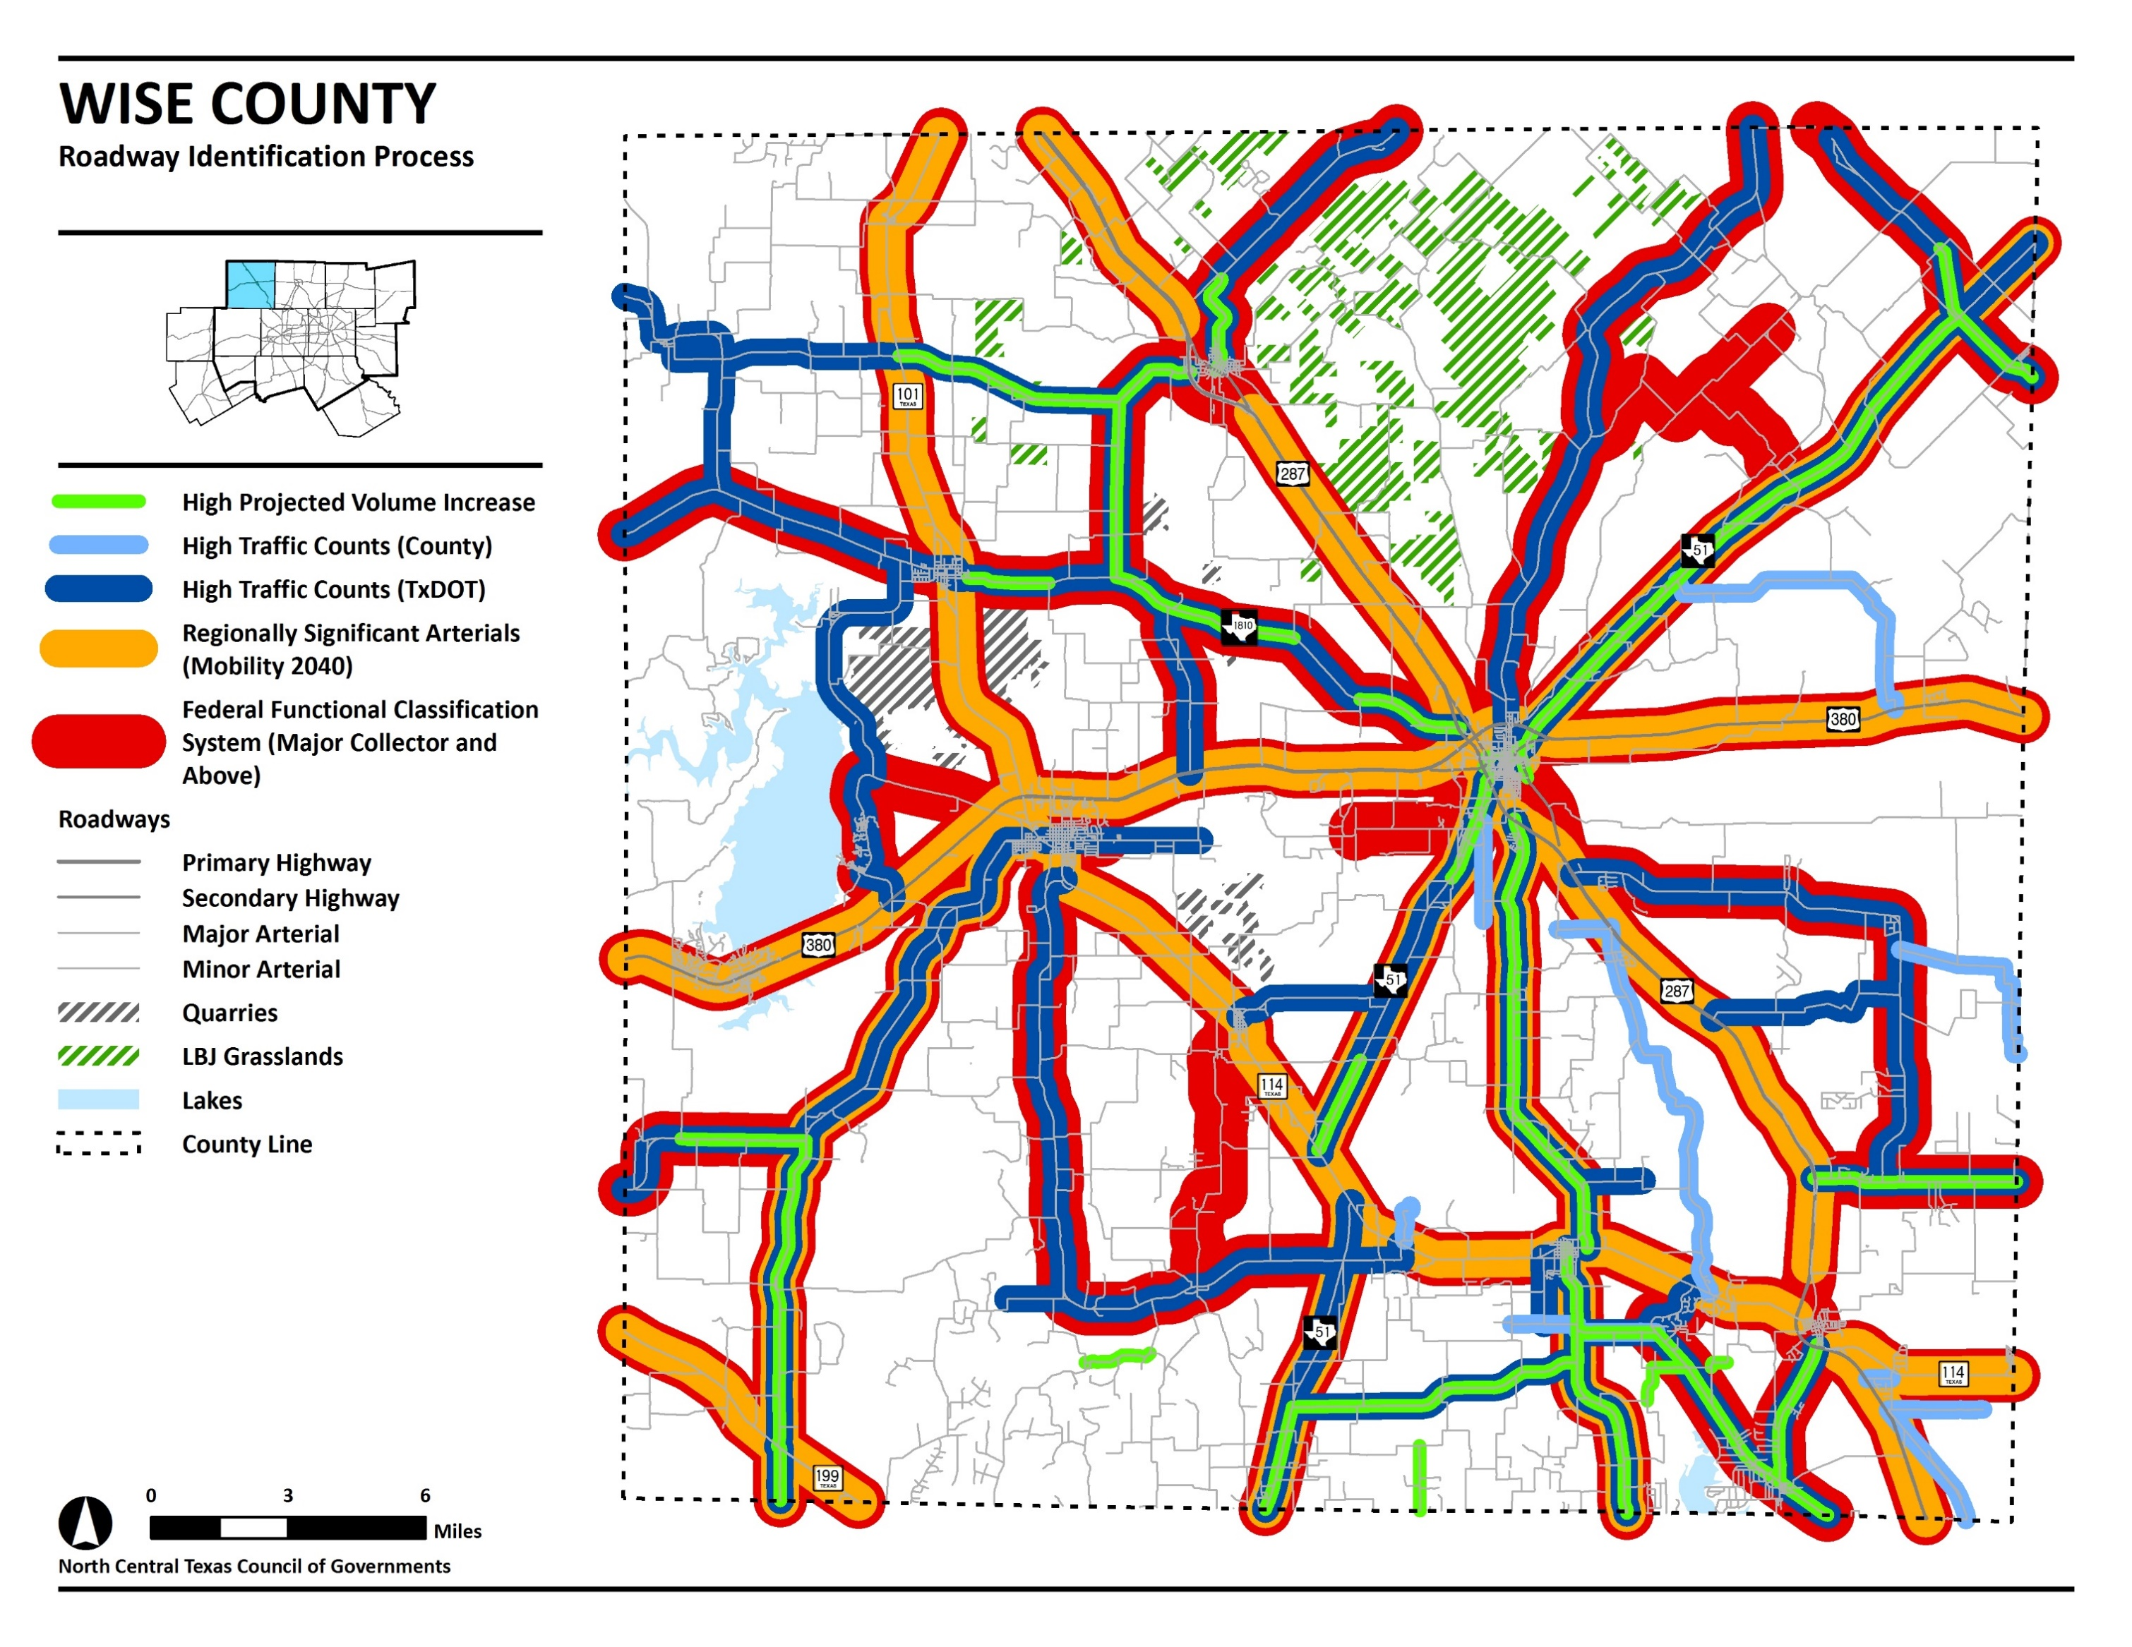
9
DRAFT DOCUMENT

Slide 10
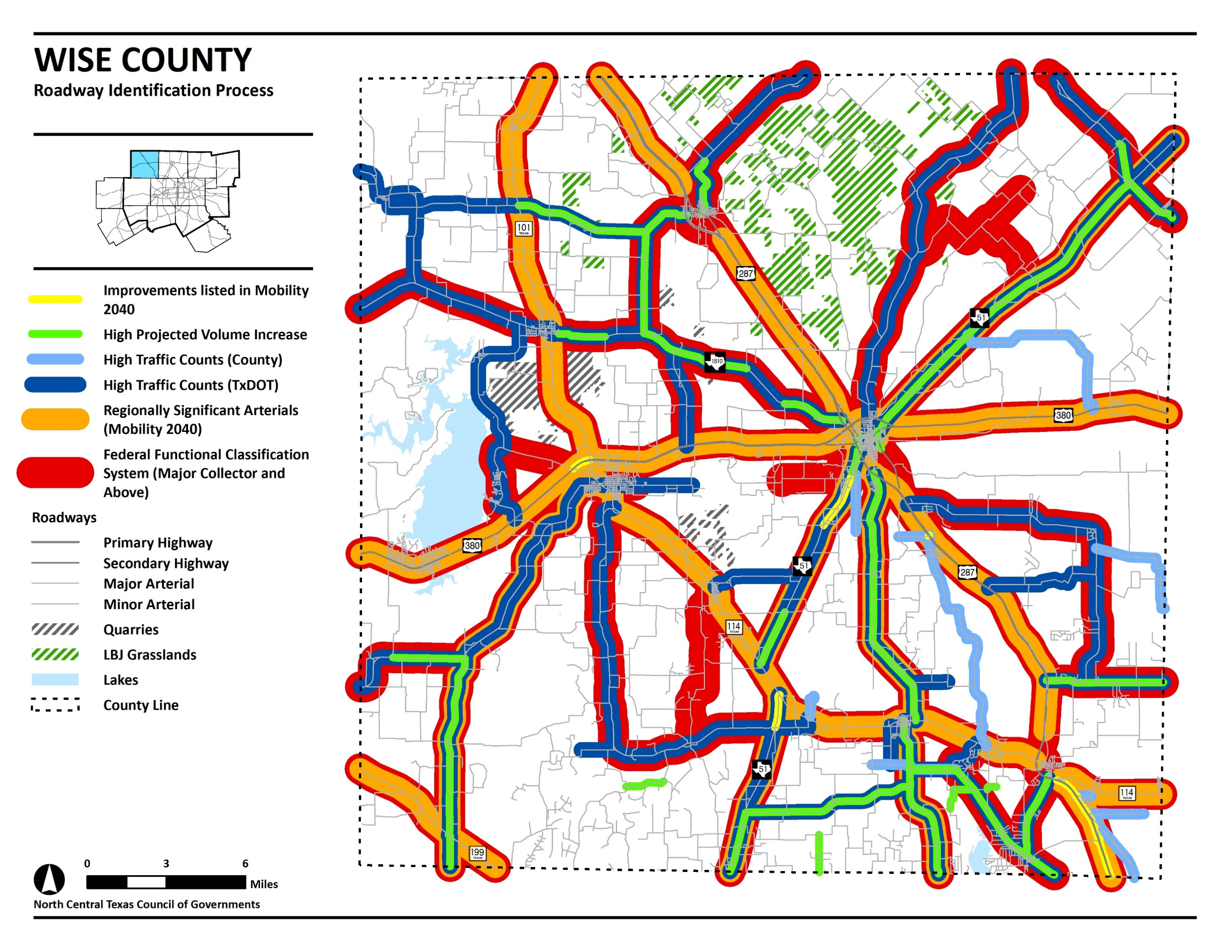
10
DRAFT DOCUMENT

Slide 11
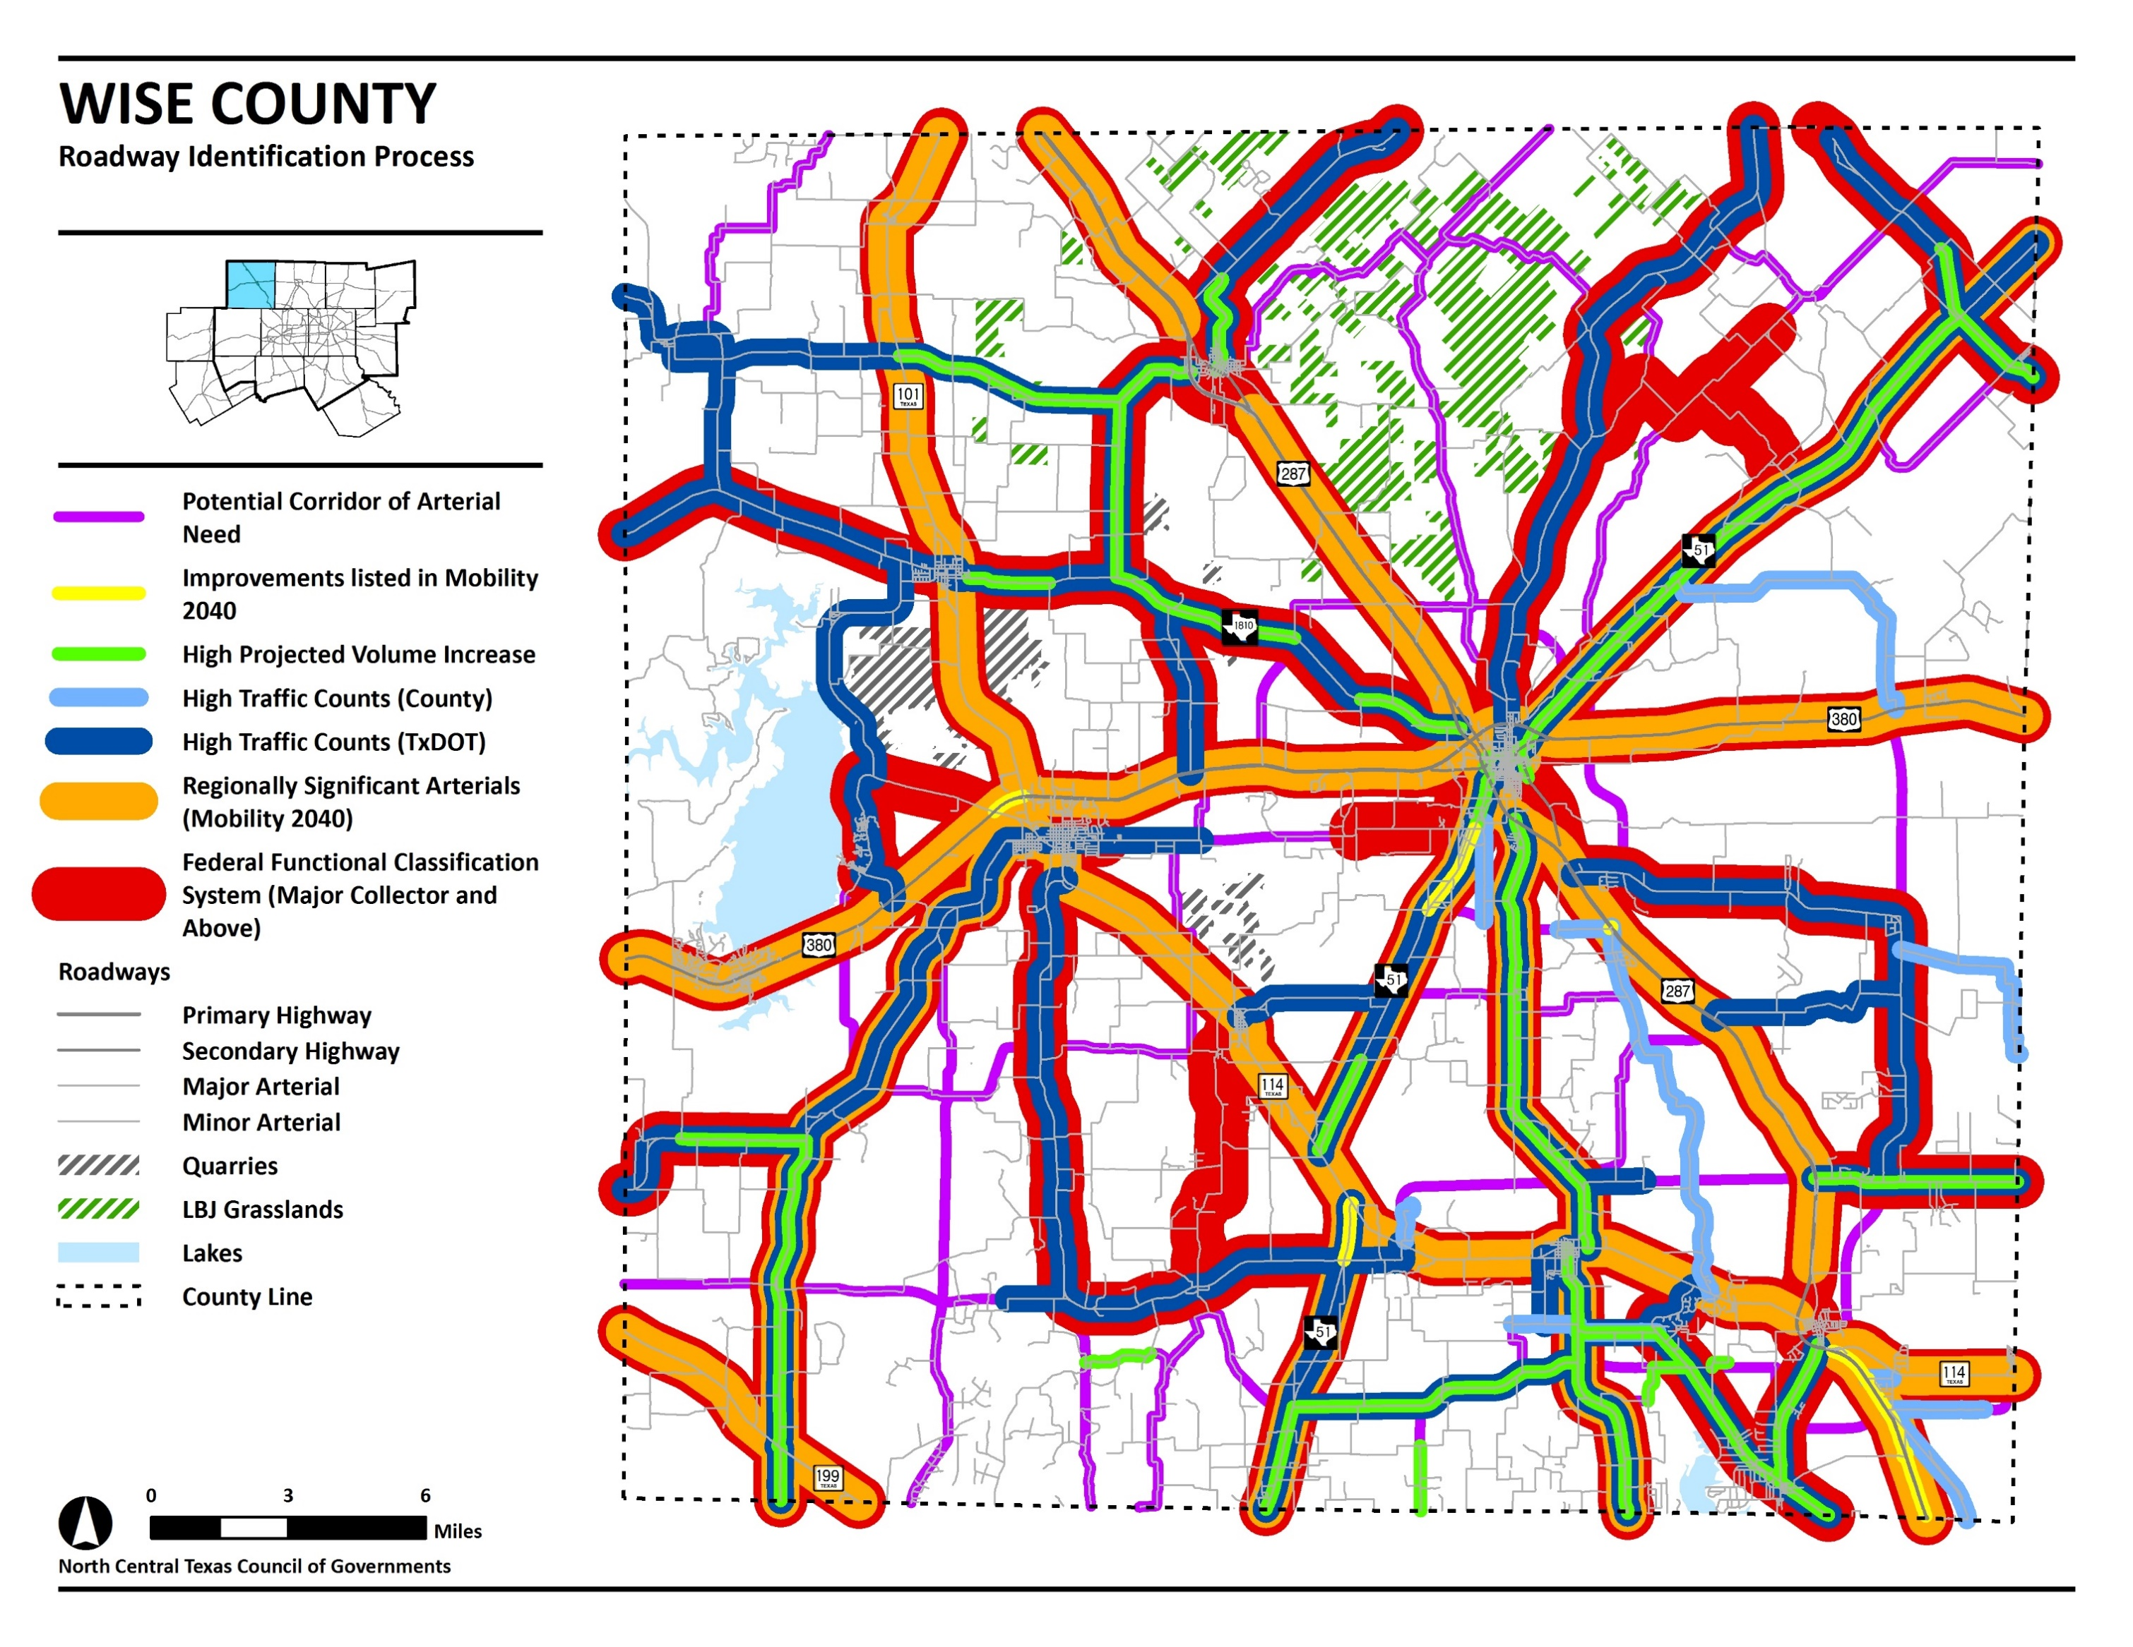
11
DRAFT DOCUMENT

Slide 12
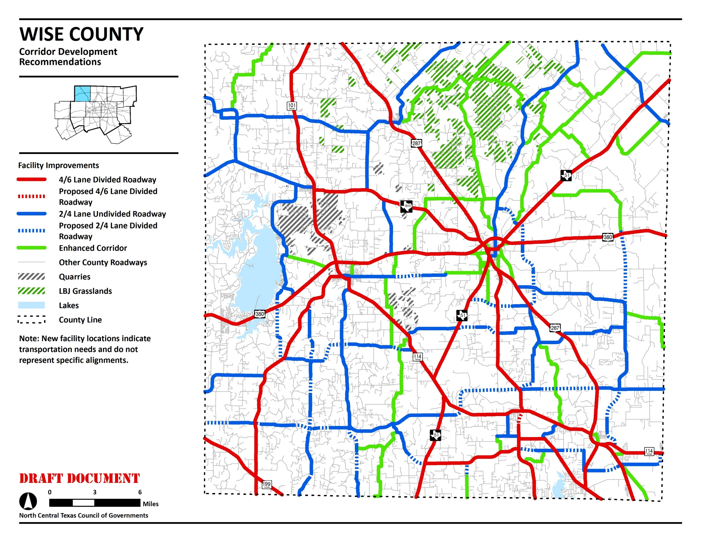
12
DRAFT DOCUMENT

Slide 13
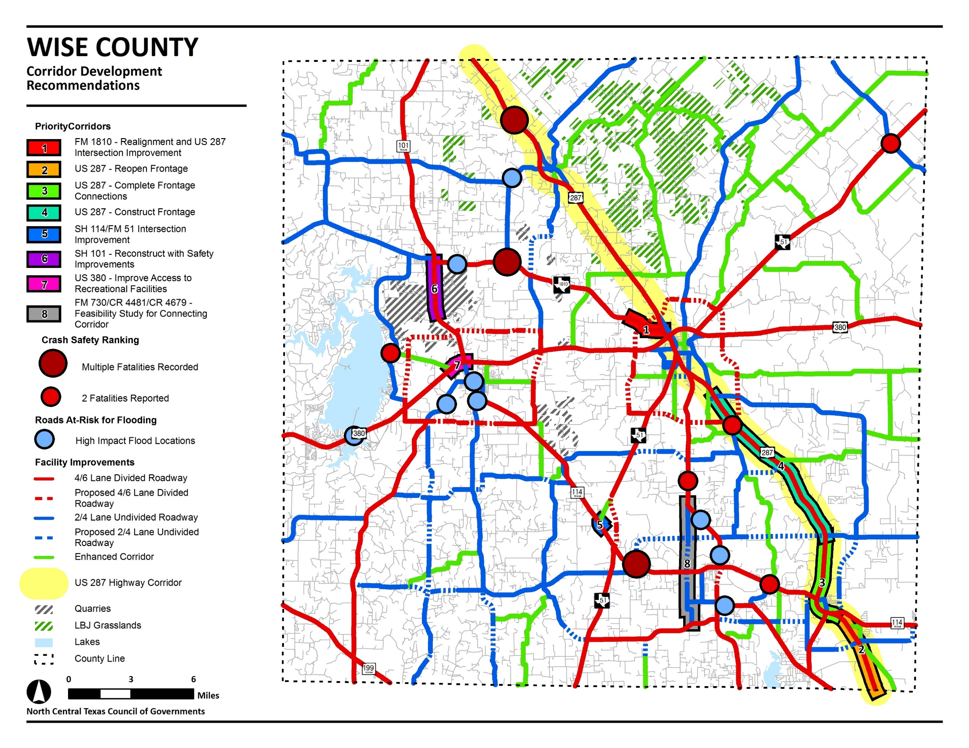
13
DRAFT DOCUMENT

Slide 14
Wise county transportation plan
14
QUESTIONS?
CONTACT INFORMATION
Chris Reed
Project Manager
Principal Transportation Planner
Phone: (817) 695-9271
email: creed@nctcog.org
David Tidwell
Transportation Planner III
Phone: (817) 704-5602
email: dtidwell@nctcog.org

